Slide 1
CHAPTER 2(2)
Describing Syntax and Semantics

Slide 2
DYNAMIC SEMANTICS
Describing syntax is relatively simple
There is no single widely acceptable notation or formalism for describing semantics
If there were a precise semantics specification of a programming language, programs written in the language potentially could be proven correct without testing, correctness of compilers could be verified.
CCSB314 Programming Language
1-<number>

Slide 3
APPROACHES IN (DYNAMIC) SEMANTICS
Operational Semantics
  Describe the meaning of a program by executing its statements on a machine, either simulated or actual. The change in the state of the machine (memory, registers, etc.) defines the meaning of the statement
Denotational semantics
  Using mathematical and logic approach.
Axiomatic Semantics
  Specifies what can be proven about the program, rather than directly specifying the meaning of a program.
CCSB314 Programming Language
1-<number>

Slide 4
OPERATIONAL SEMANTICS
To describe the meaning of a statement or program by specifying the effects of running it on a machine.
Machine language shows sequence of changes in state, but problems to be used as formal description:
  Too small and too numerous of individual steps in machine language
  Too large and complex storage architecture
Different levels of uses:
  At highest level, use with interest in the final result (natural ops. Semantics).
  At lowest level, to determine the precise meaning of program (structural ops. Semantics)
CCSB314 Programming Language
1-<number>

Slide 5
OPERATIONAL SEMANTICS (CONTINUED)
The basic process:
  Design appropriate intermediate language that is clear and unambiguous
CCSB314 Programming Language
1-<number>

Slide 6
OPERATIONAL SEMANTICS (CONTINUED)
C statement
for ( expr1; expr2; expr3) {
…;
…;
}
Meaning :
expr1;
loop : if expr2 == 0 goto out
…
expr3;
goto loop
out : …
CCSB314 Programming Language
1-<number>

Slide 7
OPERATIONAL SEMANTICS (CONTINUED)
Evaluation of operational semantics:
  Good if used informally (language manuals, etc.)
  Extremely complex if used formally (e.g., VDL), it was used for describing semantics of PL/I.
  Provides an effective means of describing semantics for language users and language implementers – as long as the descriptions are kept simple and informal.
  Depends on programming language of lower level, not mathematics – the statement of one programming language are described in terms of the statements of a lower-level programming language.
CCSB314 Programming Language
1-<number>

Slide 8
DENOTATIONAL SEMANTICS
Based on recursive function theory
The most abstract semantics description method
Originally developed by Scott and Strachey (1970)
CCSB314 Programming Language
1-<number>

Slide 9
DENOTATIONAL SEMANTICS (CONTINUED)
The process of building a denotational specification for a language
Define a mathematical object for each language entity
  Define a function that maps instances of the language entities onto instances of the corresponding mathematical objects
The meaning of language constructs are defined by only the values of the program's variables
CCSB314 Programming Language
1-<number>

Slide 10
DENOTATIONAL SEMANTICS VERSUS OPERATIONAL SEMANTICS
In operational semantics, the state changes are defined by coded algorithms
In denotational semantics, the state changes are defined by rigorous mathematical functions
CCSB314 Programming Language
1-<number>

Slide 11
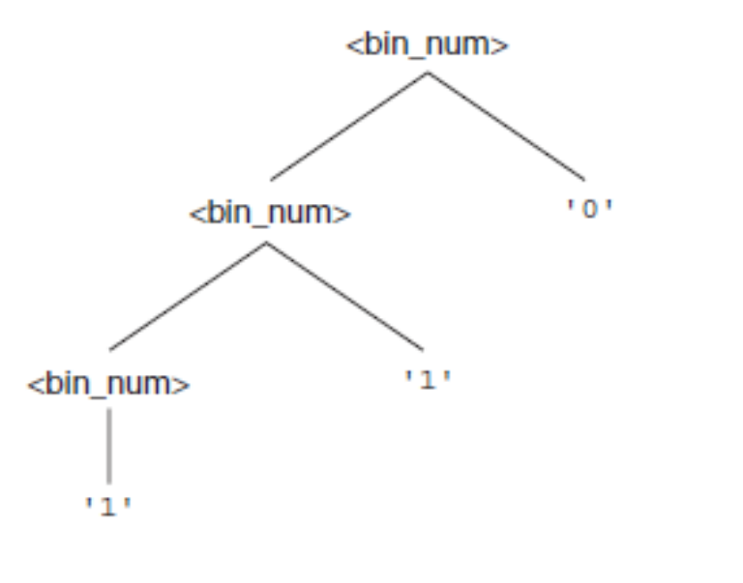
DENOTATIONAL SEMANTICS EXAMPLE
The following rule to describe the binary number
<bin_num> → ‘0’
| ‘1’
| <bin_num> ‘0’
| <bin_num> ‘1’
A parse tree for the example binary number, 110,
CCSB314 Programming Language
1-<number>

Slide 12
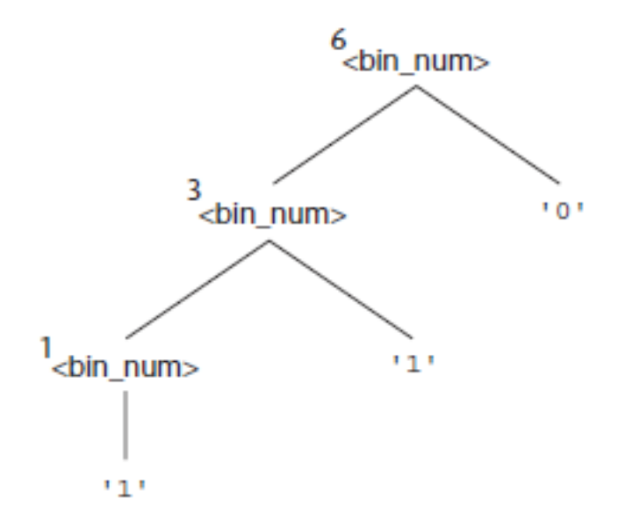
DENOTATIONAL SEMANTICS EXAMPLE
The following rule to describe the binary number of a decimal number
Mbin('0') = 0
Mbin('1') = 1
Mbin(<bin_num> '0') = 2 * Mbin(<bin_num>)
Mbin(<bin_num> '1') = 2 * Mbin(<bin_num>) + 1
Example the decimal number 6
CCSB314 Programming Language
1-<number>

Slide 13
DENOTATIONAL SEMANTICS EXAMPLE
<dec_num> → 0 | 1 | 2 | 3 | 4 | 5 | 6 | 7 | 8 | 9
| <dec_num> (0 | 1 | 2 | 3 | 4 | 5 | 6 | 7 | 8 | 9)
M_{dec}('0') = 0, M_{dec} ('1') = 1, …, M_{dec} ('9') = 9
M_{dec} (<dec_num> '0') = 10 * M_{dec} (<dec_num>)
M_{dec} (<dec_num> '1’) = 10 * M_{dec} (<dec_num>) + 1
…
M_{dec} (<dec_num> '9') = 10 * M_{dec} (<dec_num>) + 9
CCSB314 Programming Language
1-<number>

Slide 14
DENOTATIONAL SEMANTICS: PROGRAM STATE
The state of a program is the values of all its current variables
s = {<i₁, v₁>, <i₂, v₂>, …, <i_{n}, v_{n}>}
Let VARMAP be a function that, when given a variable name and a state, returns the current value of the variable
  VARMAP(i_{j}, s) = v_{j}
CCSB314 Programming Language
1-<number>

Slide 15
EXPRESSIONS
Map expressions onto Z ∪ {error}
We assume expressions are decimal numbers, variables, or binary expressions having one arithmetic operator and two operands, each of which can be an expression
CCSB314 Programming Language
1-<number>

Slide 16
EXPRESSIONS
Describe the semantics of the following BNF:
<expr> → <dec_num> | <var> | <binary_expr>
<binary_expr> → <left_expr> <operator> <right_expr>
<left_expr> → <dec_num> | <var>
<right_expr> → <dec_num> | <var>
<operator> → + | *
CCSB314 Programming Language
1-<number>

Slide 17
SEMANTICS (CONT.)
M_{e}(<expr>, s) Δ=
case <expr> of
<dec_num> => M_{dec}(<dec_num>, s)
<var> =>
if VARMAP(<var>, s) == undef
then error
else VARMAP(<var>, s)
<binary_expr> =>
if (M_{e}(<binary_expr>.<left_expr>, s) == undef
OR M_{e}(<binary_expr>.<right_expr>, s) =
undef)
then error
    else
    if (<binary_expr>.<operator> == ‘+’ then
    M_{e}(<binary_expr>.<left_expr>, s) +
    M_{e}(<binary_expr>.<right_expr>, s)
    else M_{e}(<binary_expr>.<left_expr>, s) *
    M_{e}(<binary_expr>.<right_expr>, s)
    ...
CCSB314 Programming Language
1-<number>

Slide 18
ASSIGNMENT STATEMENTS
Maps state sets to state sets
Ma(x := E, s) Δ=
if Me(E, s) == error
then error
else s’ = {<i₁’,v₁’>,<i₂’,v₂’>,...,<i_{n}’,v_{n}’>},
where for j = 1, 2, ..., n,
if i_{j} == x
then v_{j} = Me(E, s)
else v_{j} = VARMAP(i_{j}, s)
CCSB314 Programming Language
1-<number>

Slide 19
LOGICAL PRETEST LOOPS
Maps state sets to state sets
M_{l}(while B do L, s) Δ=
if M_{b}(B, s) == undef
then error
else if M_{b}(B, s) == false
then s
else if M_{sl}(L, s) == error
then error
else M_{l}(while B do L, M_{sl}(L, s))
CCSB314 Programming Language
1-<number>

Slide 20
LOOP MEANING
The meaning of the loop is the value of the program variables after the statements in the loop have been executed the prescribed number of times, assuming there have been no errors
In essence, the loop has been converted from iteration to recursion, where the recursive control is mathematically defined by other recursive state mapping functions
Recursion, when compared to iteration, is easier to describe with mathematical rigor
CCSB314 Programming Language
1-<number>

Slide 21
EVALUATION OF DENOTATIONAL SEMANTICS
Can be used to prove the correctness of programs
Provides a rigorous way to think about programs
Can be an aid to language design
Has been used in compiler generation systems
Because of its complexity, they are of little use to language users
CCSB314 Programming Language
1-<number>

Slide 22
AXIOMATIC SEMANTICS
Based on formal mathematical logic
Original purpose: formal program verification – to prove the correctness of programs.
The meaning of a program is based on relationships among program variables and constants, which are the same for every execution of the program.
Two distinct applications:
  Program verification
  Semantics specification
CCSB314 Programming Language
1-<number>

Slide 23
AXIOMATIC SEMANTICS (CONTINUED)
Axioms or inference rules are defined for each statement type in the language (to allow transformations of expressions to other expressions)
The expressions are called assertions
An assertion before a statement, a precondition, states the relationships and constraints among variables that are true at that point in execution
An assertion following a statement is a postcondition that describes the new constraints on those variables after execution of the statement
A weakest precondition is the least restrictive precondition that will guarantee the postcondition
CCSB314 Programming Language
1-<number>

Slide 24
AXIOMATIC SEMANTICS FORM
Pre-, post form: {P} statement {Q}
An example
  a = b + 1 {a > 1}
  One possible precondition: {b > 10}
  Weakest precondition: {b > 0}
CCSB314 Programming Language
1-<number>

Slide 25
PROGRAM PROOF PROCESS
The postcondition for the entire program is the desired result
  Work back through the program to the first statement. If the precondition on the first statement is the same as the program specification, the program is correct.
CCSB314 Programming Language
1-<number>

Slide 26
PROVING ASSIGNMENT STATEMENTS
The usual notation is
  {P} S {Q}
  E.g.
  a = b / 2 – 1 {a < 10}
  The weakest precondition is computed by substituting b / 2 – 1 for a in the postcondition {a < 10}.
  b / 2 – 1 < 10
  b < 22
Therefore, the weakest precondition is {b < 22}
CCSB314 Programming Language
1-<number>

Slide 27

PROVING SEQUENCES
An inference rule for sequences
{P1} S1 {P2}
{P2} S2 {P3}
– antecedent
- consequent
If antecedent are true, then truth of consequent can be inferred
CCSB314 Programming Language
1-<number>

Slide 28
PROVING SEQUENCES
For example, consider the following sequence and postcondition:
y = 3 * x + 1;
x = y + 3;
{x < 10}
The precondition for the second assignment statement is
y < 7
which is used as the postcondition for the first statement. The precondition for
the first assignment statement can now be computed:
3 * x + 1 < 7
x < 2
So, {x < 2} is the precondition of both the first statement and the twostatement
sequence.
CCSB314 Programming Language
1-<number>

Slide 29
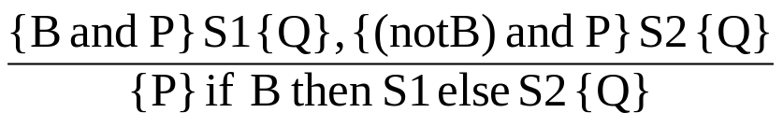
PROVING SELECTION
An inference rule for selection
if B then S1 else s2
– antecedent
- consequent
The selection statement must be proven for both when the boolean expression is true and false.
We need a precondition P that can be used in the precondition of both the then and else clause.
CCSB314 Programming Language
1-<number>

Slide 30
PROVING SELECTION (CONTINUED)
Example
if x >0 then
y= y - 1
else
y= y + 1
Suppose Q is {y > 0}, using rule of consequence, the precondition for the whole statement is {y > 1}.
CCSB314 Programming Language
1-<number>

Slide 31
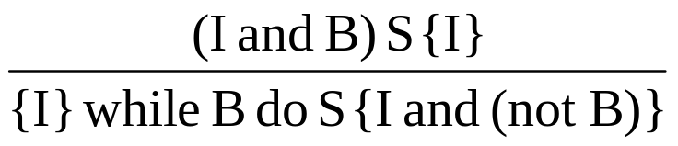
PROVING LOOP
An inference rule for logical pretest loops
The axiomatic description of a while loop is written as
{P} while B do S end {Q}
where I is the loop invariant (the inductive hypothesis)
CCSB314 Programming Language
1-<number>

Slide 32
PROVING LOOP
E.g.
  while y <> x do y = y + 1
Zero iteration, wp is obviously {y = x}
One iteration, wp is
  y = y + 1, {y = x}) = {y + 1 = x}, or {y = x - 1}
Two iterations? Three iterations?
Therefore, {y <= x} is the precondition {P}
CCSB314 Programming Language
1-<number>

Slide 33
PROVING LOOP
Characteristics of the loop invariant: I must meet the following conditions:
  P => I -- the loop invariant must be true initially
  {I and B} S {I} -- I is not changed by executing the body of the loop
  (I and (not B)) => Q -- if I is true and B is false, is implied
  The loop terminates
CCSB314 Programming Language
1-<number>

Slide 34
PROVING LOOP
P => I
  In this case, I is used as precondition. Because P = I, P => I.
{I and B} S {I}
  {y <= x and y <> x} y = y + 1 {y <= x}
  Applying the axiom to y = y + 1 {y <= x} we get {y + 1 <= x}, which is equivalent to {y < x}, which is implied by {y <= x and y <> x}
  So, proven
(I and (not B)) => Q
  {(y <= x and (not (y <> x)))} => {y = x}
  {(y <=x and (y = x)) => {y = x}
  {y = x} => {y = x}
The loop terminates
  {y <= x} while y <> x do y = y + 1 end {y = x}
CCSB314 Programming Language
1-<number>

Slide 35
PROVING LOOP
The loop invariant I is a weakened version of the loop postcondition, and it is also a precondition.
I must be weak enough to be satisfied prior to the beginning of the loop, but when combined with the loop exit condition, it must be strong enough to force the truth of the postcondition
CCSB314 Programming Language
1-<number>

Slide 36
EVALUATION OF AXIOMATIC SEMANTICS
Developing axioms or inference rules for all of the statements in a language is difficult
It is a good tool for correctness proofs, and an excellent framework for reasoning about programs, but it is not as useful for language users and compiler writers
Its usefulness in describing the meaning of a programming language is limited for language users or compiler writers
CCSB314 Programming Language
1-<number>

Slide 37
SUMMARY
BNF and context-free grammars are equivalent meta-languages
  Well-suited for describing the syntax of programming languages
An attribute grammar is a descriptive formalism that can describe both the syntax and the semantics of a language
Three primary methods of semantics description
  Operation, axiomatic, denotational (others:
    Domain theory and fixed point, Algebraic, Action & Translational Semantics
CCSB314 Programming Language
1-<number>

